Slide 1
Mining the Electronic Health Record
Steve Simon, Department of Biomedical and Health Informatics, UMKC

Slide 2
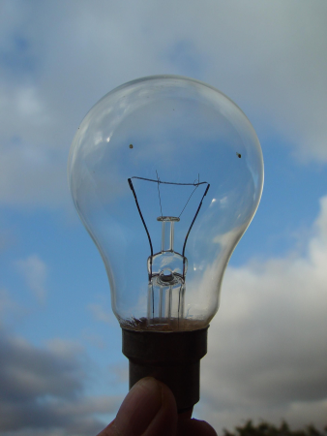
How many researchers…?
image of a light bulb
Notes:
Let’s start with a bad joke. How many researchers does it take to screw in a lightbulb? Fifteen. One to screw in the lightbulb and fourteen to serve as co-authors.
I have to admit I’m one of those fourteen. I written some of my own articles, but some of my best work is when I’m third, fifth, or eight co-author.

Slide 3

The best thing about being a statistician…
John Tukey
Notes:
I’m in strong agreement with the famous statistician, John Tukey, who said “The best thing about being a statistician is that you get to play in everyone’s backyard.”

Slide 4
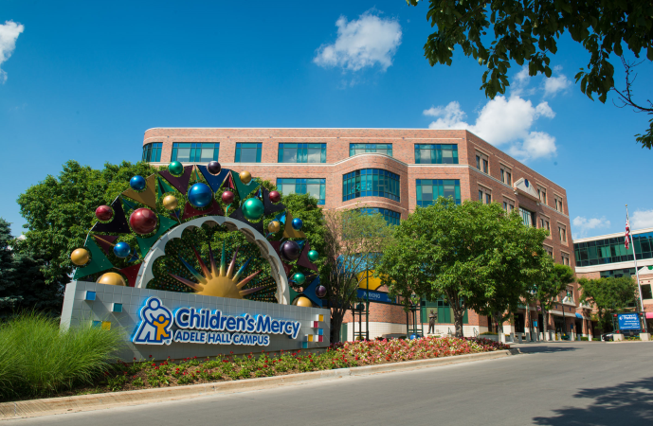
Backyard #1
Children’s Mercy Hospital building
Notes:
Here are some of the local backyards I’ve gotten to play in. Children’s Mercy, …

Slide 5
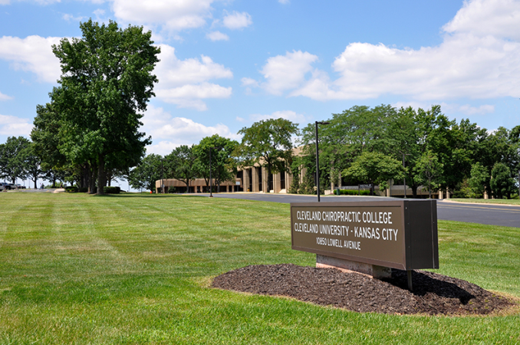
Backyard #2
Cleveland Chiropractic College building
Notes:
…, Cleveland Chiropractic, …

Slide 6
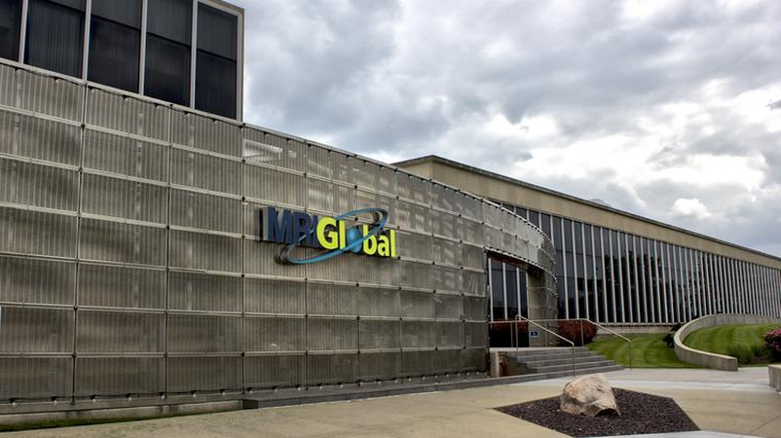
Backyard #3
MRI Global building
Notes:
…, MRI Global, …

Slide 7
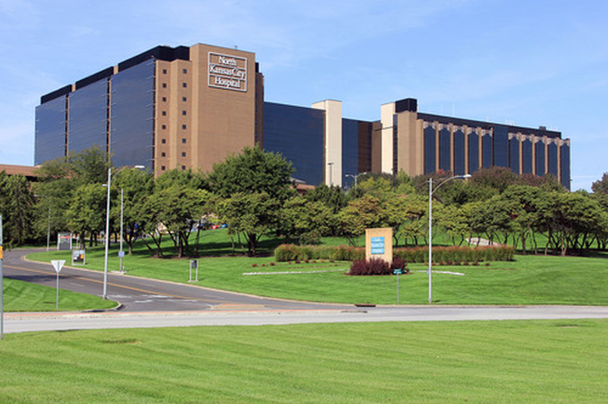
Backyard #4
North Kansas City Hospital building
Notes:
…, North Kansas City Hospital, …

Slide 8
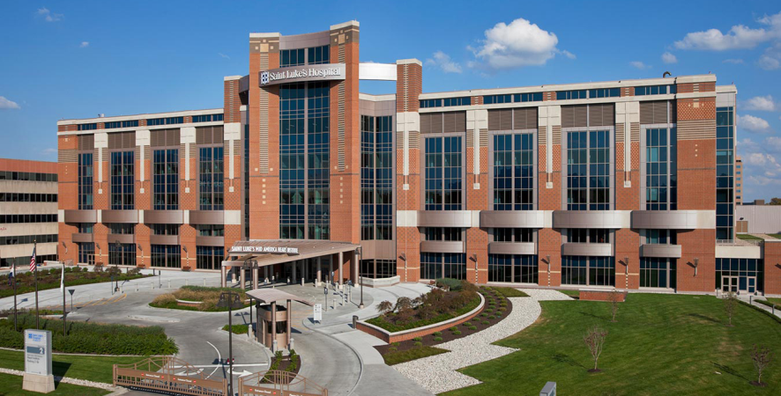
Backyard #5
Saint Luke’s Hospital building
Notes:
…, Saint Luke’s Hospital, …

Slide 9
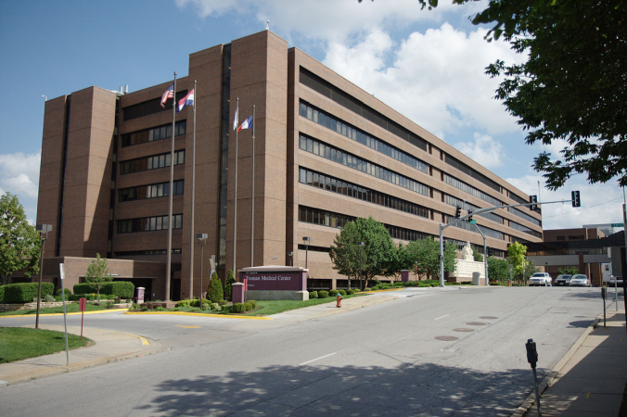
Backyard #6
Truman Medical Center building
Notes:
…, and Truman Medical Center, …

Slide 10

My favorite two backyards
UMKC and KUMC mascots
Notes:
… but my two favorite backyards are UMKC and KUMC. UMKC pays most of my salary, but I have worked on the committee that provided oversight to all the Data Safety and Monitoring Boards at KUMC. I co-authored a several publications on Bayesian models with KUMC faculty. I helped out with the National Database of Nursing Quality Indicators. I provided informal support to one of the first PhD graduates from the Biostatistics Department. So I consider myself to be half Kangaroo and half Jayhawk. Would that be a Kangjay or a Hawkaroo?

Slide 11
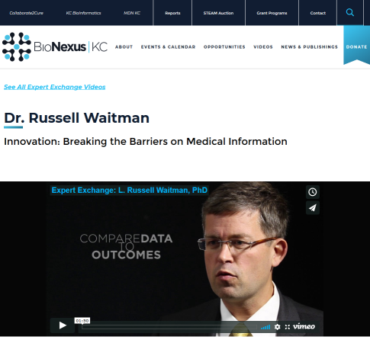
New backyard: Russ Waitman
Russ Waitman
Notes:
So when this guy [pause] offered me a chance to work at KU Med Center in Medical Informatics, I said “Heck yes!” Now this wasn’t easy. I had child care commitments and so to find the time to work with Russ I needed to drop some really good things at UMKC. But I had to do this, because Medical Informatics is just like Statistics. They also get to play in everyone’s backyard.

Slide 12
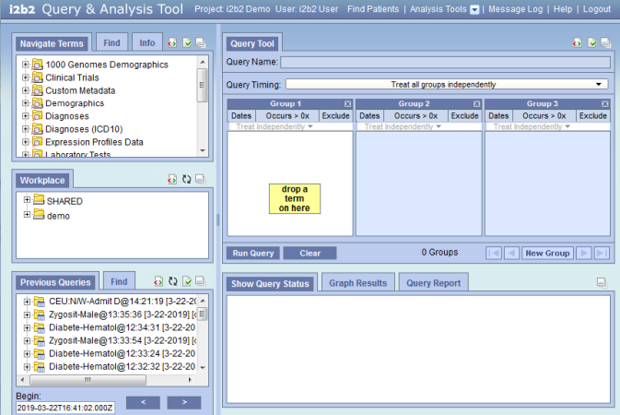
i2b2 software
Screenshot of i2b2 software
Notes:
The common standard for research using the electronic health record is i2b2.
It’s an open standard which should be attractive to anyone in this audience who is a student. You learn i2b2 here, and everything you learn will transfer directly to the job you get after you graduate.
They are using i2b2 at some of the local playgrounds that I showed earlier: Children’s Mercy, Saint Luke’s, and Truman Medical Center. But the i2b2 system at KU Med Center is really great. They’ve included records from both the billing side and the clinical side. How cool is that! They’ve integrated the electronic health record with a cancer registry and a trauma registry. They have a slick system called data builder, which dumps the i2b2 records into a SQLite database that you can import into R, and they even let mere mortals like me query directly from the actual database.
The i2b2 software is great for targetted research involving a well structured research hypothesis. But for data mining, which is a more unstructured approach, you have to dig a bit deeper.

Slide 13
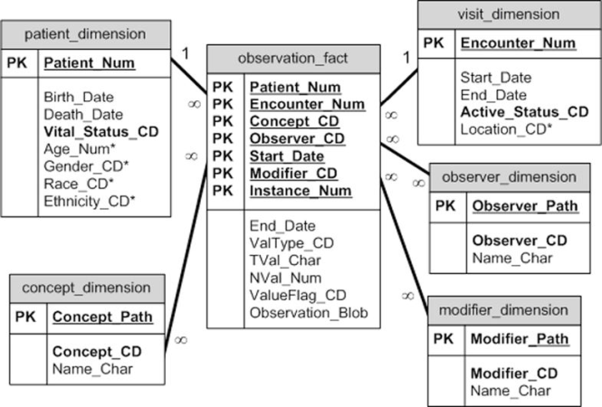
The database structure behind i2b2
Diagram of i2b2 schema
Notes:
Here’s the database schema for i2b2. For something as complex as the Electronic Health Record, it’s a very spartan design. It has to be, as we’ll see in a minute.

Slide 14
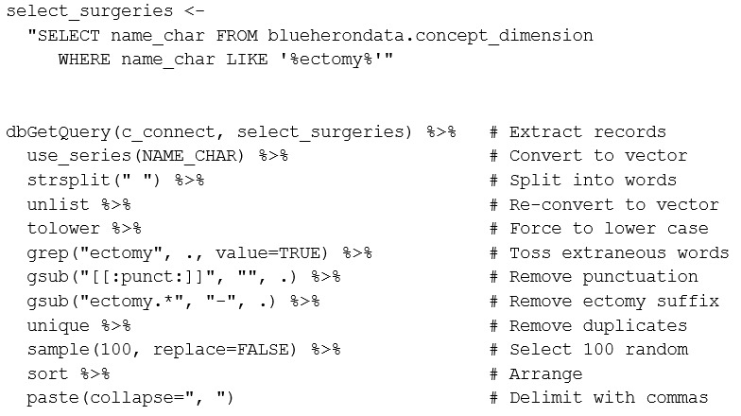
How many surgeries?
Screenshot of SQL and R code

Slide 15
## How many surgeries?
select_surgeries <- "SELECT name_char FROM blueherondata.concept_dimension WHERE name_char LIKE '%ectomy%'" dbGetQuery(c_connect, select_surgeries) %>% # Extract records use_series(NAME_CHAR) %>% # Convert to vector strsplit(" ") %>% # Split into words unlist %>% # Re-convert to vector tolower %>% # Force to lower case grep("ectomy", ., value=TRUE) %>% # Toss extraneous words gsub("[[:punct:]]", "", .) %>% # Remove punctuation gsub("ectomy.*", "-", .) %>% # Remove ectomy suffix unique %>% # Remove duplicates sample(100, replace=FALSE) %>% # Select 100 random sort %>% # Arrange paste(collapse=", ") # Delimit with commas
Notes:
Here’s something simple you can only do easily if you can directly query the database. This is a simple program for getting a list of certain types of operations. You’re looking for the suffix “ectomy” which is Greek for “cut it out.” Here’s a bit of SQL code and some post-processing in R. You should be able to do this in SAS as well, but I haven’t tested it yet.

Slide 16
How many surgeries?
“acromion-, adenoid-, alveol-, apic-, apico-, arthr-, arytenoid-, astragal-, ather-, burs-, capsul-, carp-, clitor-, coccyg-, crani-, dacryoaden-, dacryocyst-, diaphys-, disarticulationhemipelv-, disk-, diverticul-, endarter-, epididym-, epiglottid-, epiplo-, ethmoid-, fasci-, fistul-, frenul-, ganglion-, gastr-, gingiv-, gloss-, hemigastr-, hemigloss-, hemilamin-, hemilaryng-, hemiphalang-, hemorrhoid-, hepat-, hymen-, hyster-, infundibul-, irid-, labyrinth-, lamin-, lip-, lump-, mucos-, my-, myom-, nephr-, nephroureter-, oophor-, osteophyt-, pannicul-, patell-, phalang-, pharyngolaryng-, phleb-, pleur-, plex-, pneumon-, postadenoid-, postcholecyst-, postgastr-, postlymphaden-, postmastoid-, postpolyp-, postprostat-, postsplen-, prostat-, rectosigmoid-, salping-, salpingoophor-, scler-, segment-, sequestr-, sialoaden-, sigmoid-, sphenoid-, sympath-, synov-, tenon-, tenosynov-, trabecul-, trachel-, trisection-, trisegment-, turbin-, tyl-, tympanomastoid-, umbil-, urethr-, uvul-, vagin-, valv-, vas-, vesicul-, vulv-”
Notes:
The full list of “ectomies” would be about twice as big. And that illustrates a key challenge with this type of data. It is very sparse. There are hundreds of things that a surgeon can cut out of you, but you should be very grateful that the doctor only chops out one or two things at the most. Looking at the drugs that you could get, even the worst polypharmacy cases would be a small fraction of thousands of drugs that are available. The number of diagnosis codes that you are assigned is also a small fraction of the number of diagnoses that they could hang on you. So the design matrix for any regression model in this area becomes really huge and most of the entries are zeros.
The other thing about the electronic health record is that each operation, each drug, each diagnosis code sits on a separate record. It has to, or the record would string out so long that it would be unmanageable. So you can’t say “Give me the record for a patient with sleep apnea getting Propofol anesthetic for a septoplasty.” Instead, you have to match the apnea record with the Propofol record with the septoplasty records. This means using a self-join. Self-joins are tricky. They usually require using nested queries and they can be very inefficient.
I don’t want to scare you away though. Mining the electronic health records has been one of the most fun backyards I’ve had a chance to play in.

Slide 17

Mei Liu, Acute Kidney Injury
Mei Liu, next to one of her research publications
Notes:
Now, what I’ve shown you so far isn’t too fancy, but there’s someone else in Medical Informatics, Mei Liu. She has several research publications on Acute Kidney Injury, a big NSF grant, and a PostDoc working with her. She’s a lot smarter than I am, but I know all the good light bulb jokes.

Slide 18
Requirements needed for mining the electronic health record
Technical requirements
Working familiarity with SQL
Data wrangling skills
Non-technical requirements
Lust for data
An interesting backyard
Notes:
So if you want to work in this area that I call “Mining the electronic health record” you need four things. You need to have a working knowledge of SQL. Not at the level of a database administrator, but you do have to know how to use the WHERE clause, the various types of joins, and a few other basic things. You also have to be pretty good at data wrangling. Data wrangling is a term that some guy (I’m sure it was a guy) developed to make the term data management sound more macho.
More important than these technical skills is that you have to get excited about data. If you weren’t salivating at the code that pulled every whatever-ectomy out of the database, then maybe this isn’t for you. The final requirement, though, and one that I am sure you already have, is an interesting backyard. I’m not a doctor, and all the examples I come up with on my own for mining the electronic health record are pretty trivial from a medical perspective. If you can bring me an interesting medical question, I can help you with the SQL and the data wrangling.

Slide 19
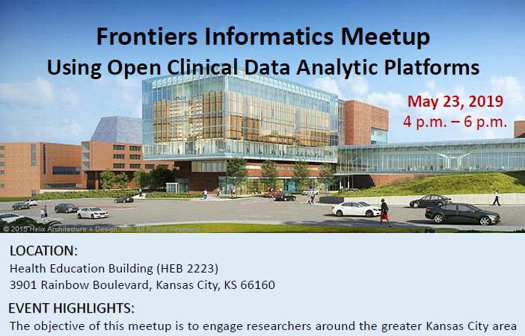
Informatics meetup
Flier for May 23 Informatics meetup
Notes:
If you want to work in this area, we have scheduled an informatics meetup on May 23. We’ll have speakers from the beginner’s intermediate, and advanced spectrum of data mining. Mei Liu and I will be running the show and we’ll bring along with a bunch of others in Russ’s department. If you’ve got an interesting backyard, we want you to be there, too.

Slide 20
Where you can find a copy of this talk.
This presentation was developed using R Markdown. You can find all the important stuff at
https://github.com/kumc-bmi/heron-i2b2-analytics
In particular, look for
doc/mining-v2-image-credits.txt
doc/mining-v2-slides.pptx
doc/mining-v2-speaker-notes.pdf

